Slide 1
Interesting case TAVI (trans-femoral approach)
R3 ยุพาพร เพ็ชรคงทอง
อ. ณรงค์ศักดิ์/ อ. กฤษณะ

Slide 2
Case
Case : ผู้ป่วยหญิง อายุ 80 ปี
Diagnosis : severe AS
Operation : transcatheter aortic valve implantation (TAVI).

Slide 3
R1
More history

Slide 4
Case
CC : แพทย์นัดมาผ่าตัด
PI : Known case severe AS รักษาต่อเนื่องที่ รพ เอกชน
- 1 ปี เหนื่อยง่ายขึ้นขณะออกแรง ทำกิจวัตรประจำวันได้ตามปกติ ไม่มีอาการเจ็บแน่นหน้าอก ไม่มีประวัติวูบหรือหมดสติ นอนราบได้ ไม่มีแขนขาบวม
- U/D : HT, DM, DLD

Slide 5
Past history
Current medication
Plavix (75) 1x1 oral pc
Azilsartan (40) 1x1 oral pc
Manidipine (10) 1x1 oral pc
Simvastatin (40) 1x1 oral hs
Bisoprolol (50) 1x1 oral pc
MFM (500) 1x1 oral pc
Doxazocin (4) 1x1 oral pc

Slide 6
Past history
- no history of drugs or food allergy
- no history of previous surgery
- no history of smoking
- no history of drinking
- Functional class I
- NPO time > 8 hrs

Slide 7
Physical examination
v/s :
BP 150/90 mmHg PR 82 bpm
RR 16 /min BT 36.6 °c
(SpO₂ room air 98%)
GA : A Thai female, good consciousness, well co-operated.
BW 68 kg Height 154 cm (BMI 28.67 kg/m²)

Slide 8
Physical examination
HEENT : not pale, no jaundice, no dry lips.
Airway :
full neck flexion and extension
thyromental distance 6 cm
mouth opening 4 cm
mallampati grade 1
dental removed

Slide 9
Physical examination
Pulmonary : normal breath sound, no adventitious sounds.
CVS : no neck vein engorged, pulse full and regular, normal s1,s2, SEM grade III at LUPSB, radiate to neck.
Abdomen : soft, no distension, not tender, no hepatomegaly.
Ext : no pitting edema.
Neuro : E4V5M6, motor gr 5 all.

Slide 10
R1
Investigations

Slide 11
Investigations
CBC :
Hb 10.1 g/dl Hct 30.6 % Plt 237,000 /mm3
Electrolyte :
Na 144 K 4.14 Cl 109.6 HC03 26.2
BUN/Cr :
13.8/1.31

Slide 12
Investigations
CBC :
FBS 130 mg%
Coagulogram :
PT/INR 10.7/ 0.91 aPTT/ratio 23.5/0.88 TT/ratio 12.3/ 0.98

Slide 13
Investigations

Slide 14
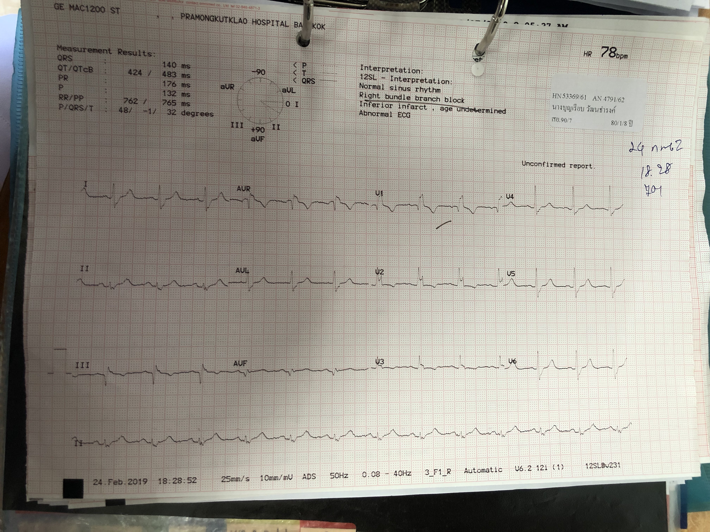
Investigations

Slide 15
Investigations
Echo :
Normal biventricular size and systolic function. LVEF 70-75% without RWMA.
Normal size both atria.
Annulus mean diameter : 22 mm, LVOT mean diameter : 20.9 mm
Severe degenerative AS with mild AR, mild MR. No other significant valvular pathology.
Grade I diastolic dysfunction.

Slide 16
R1
More investigation

Slide 17
Investigations

Slide 18
Investigations
CTA aorta
Atherosclerosis of aorta and its branches.
Calcified aortic root and mitral valve, compatible with history of valvular disease.
The bilateral common iliac arteries and Rt internal iliac artery show mild calcification.

Slide 19
R1
Problem list

Slide 20
Problem list
80 years-old Thai female diagnosis severe AS, set OR for TAVI
U/D HT, DLP, DM
Aging
ASA III

Slide 21
TAVI
Less invasive technique for treatment of severe aortic stenosis with long and short-term benefits respectively.
Often preferred in patients deemed to be of high operative risk or where open surgery is contraindicated.

Slide 22
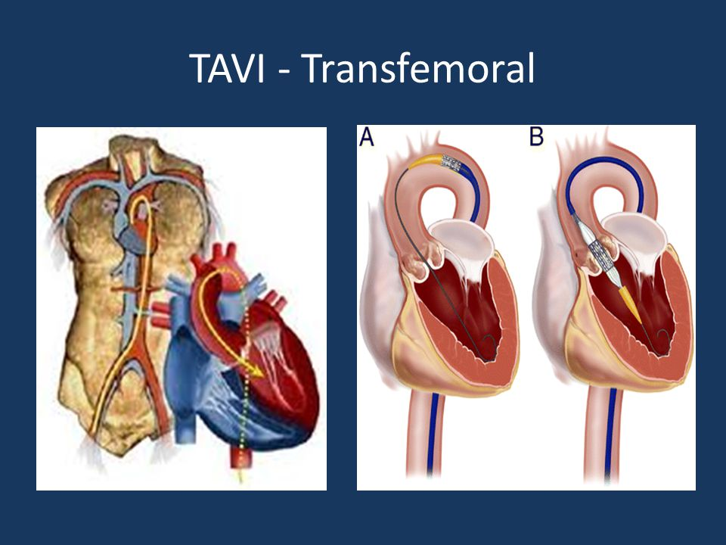
TAVI
PROCEDURAL PLAN : Trans-femoral
Trans-femoral is least invasive and most common approach.
Adequate iliofemoral vessel sizes above or equal to 7 mm with minimal calcification and tortuosity are required.

Slide 23
TAVI
PROCEDURAL PLAN : Trans-subclavian
Valve delivery distance, including the catheter, is shorter.
Improves control at deployment with more accurate positioning.
Reduce incidence of paravalvular leak and complete heart block.
Notes:
Left is preferable to right.
Valve delivery distance, including the catheter, is shorter - avoiding bending in the iliofemoral axis and thoraco-abdominal aorta.

Slide 24
TAVI
PROCEDURAL PLAN : Trans-aortic
more invasive, using an upper J shaped mini sternotomy.
Indications are diseased iliofemoral access or unsuitability for trans-apical.
Notes:
unsuitability for trans-apical route due to poor left ventricular function.

Slide 25
TAVI
PROCEDURAL PLAN : Trans-apical
Trans-apical is most invasive.
Risks such as atrial rupture, peri-operative bleeding and respiratory complications from thoracotomy increase significantly.
Notes:
Tran-apical is a useful route if porcelain aorta is present which is contraindicated via the trans-aortic approach. Advantages include no access limitation, with shorter distance and antegrade implantation route facilitating exact positioning

Slide 26
R2
Preoperative evaluation

Slide 27
Preoperative evaluation
Clinical evaluation
Symptom evaluation
Surgical risk scoring
Comorbidity
Anatomical evaluation
determine the annular size and approach

Slide 28
Preoperative evaluation

Slide 29
Preoperative evaluation
Severity of the cardiac disease
Cardiac reserve : NYHA
Chest pain
Syncope
Congestive heart failure
Cardiac dysrhythmia

Slide 30
Preoperative evaluation
Cardiovascular evaluation
EKG : LVH, arrhythmia
CXR : cardiomegaly, pulmonary edema
Echocardiography
Normal AVA 2.6-3.5 cm²
< 1 cm² significant obstruction
< 0.7 cm² severe AS
Systolic pressure gradient > 50 mmHg
AVA < 0.4 cm²
Critical outflow obstruction

Slide 31
Preoperative evaluation

Slide 32
Preoperative evaluation

Slide 33
Preoperative evaluation

Slide 34
Preoperative evaluation
Surgical risk scoring
patient is considered high-risk
EuroSCORE is >20%
EuroSCORE II is >10%
STS score is >10%
Patients are selected for TAVI based on clinical judgement and risk assessed by a multidisciplinary team of cardiologist, cardiothoracic surgeon and anesthesiologist.
Notes:
Several characteristics which may increase surgical risk (radiation, porcelain ascending aorta, multiple prior chest surgeries), or which may contraindicate TAVI (small aortic annulus, short distances between the coronary ostium and annuslus) are not included in the STS score or EuroSCORE

Slide 35
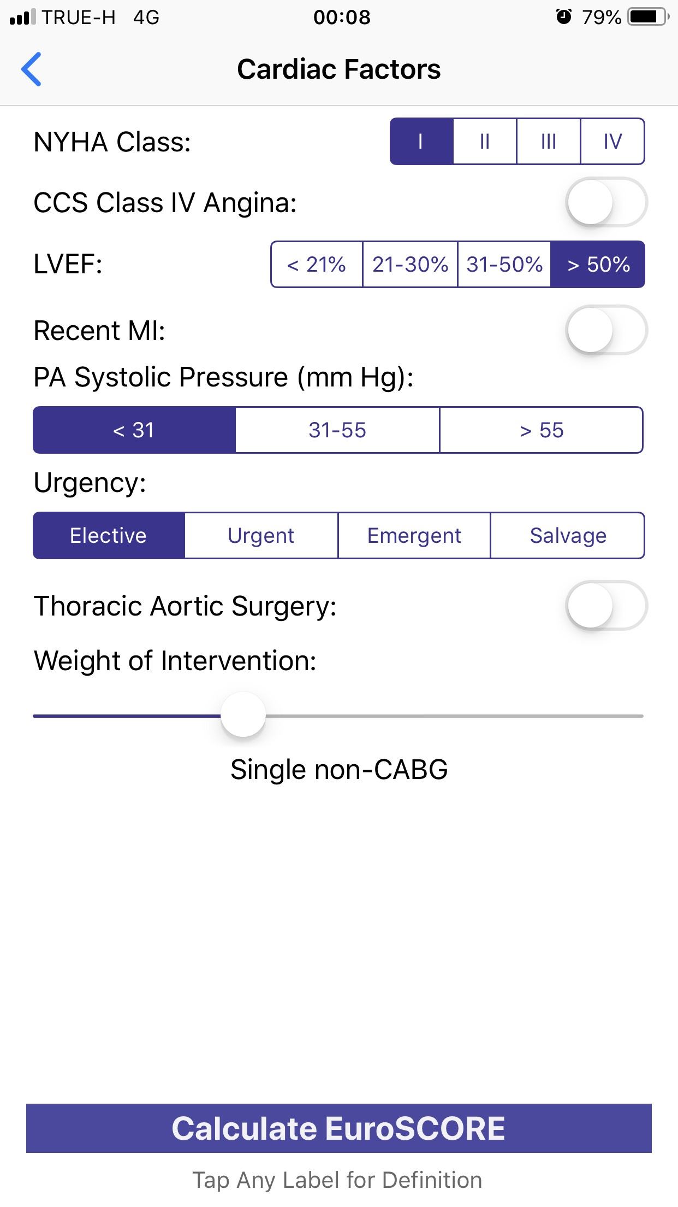
Preoperative evaluation
2.56%

Slide 36
Preoperative evaluation
Comorbidity
impaired ventricular function
pulmonary hypertension
significant mitral or tricuspid regurgitation
significant coronary artery disease with incomplete revascularization
chronic obstructive pulmonary disease (COPD)
acute/ chronic kidney disease
high risk of intraprocedural instability

Slide 37
Preoperative evaluation
Patients with severe symptomatic AS and high comorbidity (Charlson index ≥5) have a poor prognosis in the short term and do not seem to benefit from interventional treatment.
Notes:
discussion on individual patient management should take place in the Heart Team with a balanced evaluation between survival and expected quality of life versus risk of complications.
Charlson Comorbidity Index (CCI)
Predicts 10-year survival in patients with multiple comorbidities.

Slide 38
Preoperative evaluation
Anatomical evaluation
Arterial vasculature
minimal diameter larger than 6 mm is necessary.
calcium distribution in the artery.
Notes:
Underestimation of its dimensions could lead to selection and deployment of a smaller valve, with possible complications such as paravalvular regurgitation (PAR), poor hemodynamics, valve migration and embolism. Overestimation of annular size and deployment of a larger valve can lead to incomplete unfolding (with PAR as a consequence) or annular rupture.

Slide 39
Preoperative evaluation
Anatomical evaluation
Aortic valve complex
evaluation of annular size
Notes:
Underestimation of its dimensions could lead to selection and deployment of a smaller valve, with possible complications such as paravalvular regurgitation (PAR), poor hemodynamics, valve migration and embolism. Overestimation of annular size and deployment of a larger valve can lead to incomplete unfolding (with PAR as a consequence) or annular rupture.

Slide 40
R2
Preoperative preparation & premedication

Slide 41
Preoperative preparation
NPO
Informed consent
Warm IV fluid
NSS 1000 ml iv 60 ml/hr
Warmer
Large bore IV
Blood component (PRC 4U, FFP 4U, Plt 4U)
Prepare for A-line, C-line
Post operative ICU
Operating room : Hybrid, position
Communication with multidisciplinary team
Pace maker (x 2)
Intraoperative TEE
Radiation protection
Standby defibrillator, bypass pump
Medication
Drug for blunt hemodynamic : esmolol
Vasopressor : levophed
Anticoagulant & reverse : heparin, protamine

Slide 42
Premedication
Continue
ASA (81) 1*1 opc
Manidipine (10) 1x1 opc

Slide 43
Intraoperative management

Slide 44
R3
Choice of anesthesia

Slide 45
Choice of anesthesia
 | Advantage | Disadvantage
GA | Control airway/ ventilation Real time TEE information Muscle relaxant used, easy breath holding Patient comfort | Side effect of GA agent Time to establish anesthetic Cannot assess neuro sign
Conscious sedation | Awake patient (continuous neurologic status) Avoid hemodynamic instability associated with anesthetic agent Shorter procedural and recovery times | Potential for over sedation Less monitoring information Possible patient movement and discomfort Conversion to GA

Slide 46
Intraoperative
Choice of anesthesia
GA with ETT
Position
Supine
Monitoring
standard : NIBP, EKG, ETCO₂, O₂sat, Temp
invasive : A-line, C-line
specific : TEE, external defibrillator
Notes:
External defibrillator

Slide 47
R3
Anesthetic considerations

Slide 48
Anesthetic considerations Hemodynamic
Hemodynamic : use of vasopressors, inotropic agents, pacing and defibrillation.
Initial hemodynamic goals should aim to
optimise preload.
maintain systemic vascular resistance.
adequate diastolic time.
Sinus rhythm is ideal, aiming for 80 beats per minute with adequate contractility.

Slide 49
Anesthetic considerations Hemodynamic
Induction and maintenance : agent of choice depend on the procedural approach and the anesthetist.
minimally invasive procedure.
advanced age.
renal impairment.
reduction in cardiac output.

Slide 50
Anesthetic considerations Hemodynamic
Analgesic requirements are minimal for trans-femoral and moderate for trans-aortic or trans-apical routes.
Maintenance is usually via inhalational agents or TIVA, for rapid recovery and early extubation.

Slide 51
Anesthetic considerations Anticoagulation
Administer heparin 100 u/kg before BAV.
ACT of greater than 250 seconds is usually required.
Patients continue aspirin and clopidogrel pre-procedure depending on clinical requirements.

Slide 52
Anesthetic considerations Monitoring
Invasive monitoring using TEE (awake patients will have transthoracic echo).

Slide 53
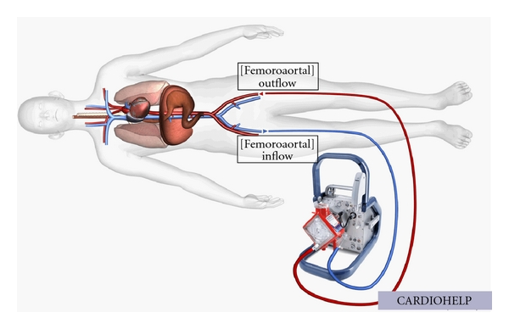
Anesthetic considerations Cardiopulmonary bypass
Provision of femoral-femoral cardiopulmonary bypass especially in those patients whose ejection fraction is less than 20%.

Slide 54
Anesthetic considerations Radiation exposure
High quality fluoroscopic equipment is used.
All staff should be protected and measures taken to avoid contrast induced kidney injury.

Slide 55
Anesthetic considerations Procedural stages
Access is gained via the femoral artery with a pigtail catheter. A trans-venous pacing wire is inserted through the femoral vein.
Pre-deployment
Balloon valvuloplasty
Positioning and deployment
Post-deployment
It is performed under rapid ventricular pacing at a rate of 180- 220 beats per minute
It is performed under RVP
MAP < 50mmHg, PP < 10 mmHg
Device position, function and vessels are assessed with angiography.

Slide 56
At OR 13.00
Standard monitoring
Preoxygenation
Premedication with fentanyl 100 mcg
Induction : propofol 20 + 50 mg
A-line, IV
Intubation : rocuronium 50 mg
C-line
Maintenance : air:O₂ : Des : 0.5:0.5 : 6%
BP 160/70 mmHg, HR 90 bpm >> esmolol 20 mg IV
Antibiotic : cefazolin 2 gm IV at 13.20
Insert TEE probe, external defibrillator
Lab base line : on hand PRC 2 u
Start operation at 14.30

Slide 57
Pre-deployment
Access Lt. femoral artery with a pigtail catheter.
A trans-venous pacing wire is inserted through the Lt. femoral vein to RV.
Titrate levophed infusion to maintain BP

Slide 58
Intraoperative period Pre-deployment
BP maintain at baseline.
it is advisable to maintain SBP more than 120 mmHg (MAP more than 75 mmHg) before the start of RVP.
Place pacing catheter and confirm 1:1 capture (VOO)
Rate 180 bpm, output 1mA
Verify MAP < 50 mmHg
Verify pulse pressure < 10 mmHg
Serious problems usually related to the femoral arterial site for the sheathed valve.
Hemorrhage, dissection and vascular rupture are all possible.
Notes:
A pre-emptive application of vasopressors prior to or immediately after RVP accelerates and facilitates recovery of blood pressure.

Slide 59
BAV
Heparin 70 mg via C-line before BAV
ACT 271 (then q 1 hr)
BAV under RVP 180 bpm

Slide 60
Intraoperative period Balloon valvuloplasty
Valvuloplasty allows for easier passage of the prosthesis.
It is performed under RVP at a rate of 180- 220 beats per minute.
may induce subsequent arrhythmia and ischemia.
Perform BAV pacing protocol

Slide 61
ACT 241 >> heparin 30 mg via c-line then ACT 383
Valve deployment
TEE for evaluate LV function, valve position and paravalvular leakage

Slide 62
Intraoperative period Positioning and deployment
Deployment devices require RVP to reduce cardiac output to
ensure stable positioning.
prevention of myocardial injury.

Slide 63
Intraoperative period Positioning and deployment
Problems during this phase
Device embolisation into the aorta or LV
Paravalvular regurgitation
Incorrect placement
Coronary ostial obstruction
Arrhythmia
Atrio-ventricular block

Slide 64
Intraoperative period Post-deployment
Device position, function and vessels are assessed with angiography.
Vessels are repaired and the delivery system removed (except transvenous pacing).
afterload on the LV has been reduced
cardiac output is increased
discontinuation of vasopressors

Slide 65
Operation time 5 hr 30 min
EBL 200 ml
IV : acetar 800ml, NSS 200 ml (total 1000 ml)
Urine output 800 ml
Narcotic : fentanyl 125 mcg with titration
Reverse with sugammadex 200 mg
Awake extubation
Transfer to ICU CVT

Slide 66
Post operative complications
Cardiac complication
Paravalvular leakage (PVL) is observed in up to 85% post-TAVI
Malposition.
Undersizing and underexpansion of the prosthesis.
Severe calcifications impairing circumferential apposition of the valve frame.
Neurologic complication
Cerebrovascular events (CVEs) are more frequently observed after TAVI than after SAVR.
The highest risk occurs immediately after (in the first 24 h) TAVI.
New-onset AF is increased risk of subacute CVE (1–30 days after TAVI).

Slide 67
Post operative complications
Renal complication
The cause of AKI is probably multifactorial
contrast-agent-induced nephrotoxicity.
renal ischemia owing to calcific/atheromatous embolism of renal arteries.
renal hypoperfusion during hypotensive episodes (rapid ventricular pacing, RVP).

Slide 68
Post operative day 1
S : ตื่นดี ไม่ปวดแผล แผลไม่ซึม ไม่มีแขนขาอ่อนแรง ไม่มีใจสั่น เจ็บคอเล็กน้อย ปัสสาวะออกปกติ
O : v/s 150/70 mmHg, HR 65 bpm, RR 18/min, BT 36.3 ⁰ C
heart & lung : normal
neuro : E₄V₅M₆, motor grade 5 all.
ext : no active bleeding
lab : Hct 24.4%, BUN/Cr 18/1.3 (base line 1.3)

Slide 69
Post operative day 1
A + P : severe AS s/p TAVI day 1
- prc 2 u drip in 3 hr/ unit
- continue ASA (300) 1*1 opc, Plavix (75) 1*1 opc
- off sheath Lt goin

Slide 70
Post operative day 2
S : ตื่นดี ไม่ปวดแผล ไม่มีแขนขาอ่อนแรง
O : v/s stable
heart & lung : normal
neuro : E₄V₅M₆, motor grade 5 all.
lab : Hct 29.1%, BUN/Cr 20/1.28
A + P : severe AS s/p TAVI day 2
- off A-line, off foley cath
- ambulate patient
- transfer to CCU
D/C on POD 5
No acute post operative complication

Slide 71
THANK YOU

